Slide 1
SDK for developing High Performance Computing Applications
China MCP

Slide 2
Agenda
HPC Introduction
Keystone Architecture
  66AK2H12 and EVM
Multicore Software Development Kit
Programming Models
  A brief history of expression APIs/languages
  Keystone II Examples
Executive Summary
  Open MPI, OpenMP, OpenMP Accelerator and OpenCL, Libraries
Getting Started Guide/Next steps

Slide 3
Agenda
HPC Introduction
Keystone Architecture
  66AK2H12 and EVM
Multicore Software Development Kit
Programming Models
  A brief history of expression APIs/languages
  Keystone II Examples
Executive Summary
  Open MPI, OpenMP, OpenMP Accelerator and OpenCL, Libraries
Getting Started Guide/Next steps

Slide 4
What is HPC
HPC---High-Performance Computing:
  High Performance Computing most generally refers to the practice of aggregating computing power in a way that delivers much higher performance than one could get out of a typical desktop computer or workstation in order to solve large problems in science, engineering, or business.
Parallelism
  HPC systems often derive their computational power from exploiting parallelism, meaning the ability to work on many computational tasks at the same time.
  HPC systems typically offer parallelism at a much larger scale, with hundreds, thousands, or (soon) even millions of tasks running concurrently. Parallelism at this scale poses many challenges

Slide 5
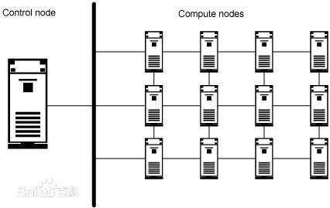
Typical HPC Structure

Slide 6
Key Requirements in HPC System
Task distribution to different compute nodes
Communication between compute nodes
High throughput I/O for data exchange
Data share and movement
Compute resource management
Data Synchronization
Task distribution for heterogeneous systems
Parallelism program on multi-core processors

Slide 7
Agenda
HPC Introduction
Keystone Architecture
  66AK2H12 and EVM
Multicore Software Development Kit
Programming Models
  A brief history of expression APIs/languages
  Keystone II Examples
Executive Summary
  Open MPI, OpenMP, OpenMP Accelerator and OpenCL, Libraries
Getting Started Guide/Next steps

Slide 8

5 generations of multicore
Lowers development effort
Speeds time to market
Leverages TI’s investment
Optimal software reuse
KeyStone Innovation
64 bit ARM v8
KeyStone III
C71x
40G Networking
ARM A15
KeyStone II
28nm
KeyStone II
28nm
Multicore cache coherency
10G Networking
KeyStone I
40nm
ARM A8
C66x fixed and floating point, FPi, VSPi
Network and Security AccelerationPacs
Concept
Faraday
65nm
C64x+
Development
Sampling
Janus
130nm
Wireless Accelerators
Production
6 core DSP
2003
2006
2011
2013/14
Future

Slide 9






KeyStone architecture
Multicore Navigator
ARM
CorePacs
Analytics
AccelerationPac
+
*
DSP
CorePacs
Wireless Radio
AccelerationPac
-
<
TeraNet
Multicore Shared
Memory Controller
Security
AccelerationPac
011100
100010
001111
HMI and
HD Graphics
CorePacs
Packet
AccelerationPac
Switching and I/O

Slide 10




66AK2H12/06
Cores & Memory
  Four 1.4 GHz ARM Cortex A15 + Eight 1.4 GHz C66x (K2H12)
  Two 1.4 GHz ARM Cortex A15 + Four 1.4 GHz C66x (K2H06)
  18MB on chip memory w/ECC
  2 x 72 bit DDR3 w/ECC, 10GB addressable memory, up to DIMM support upto 4 ranks
Multicore Infrastructure
  Navigator with 16k queues, 3200 MIPS
  2.2 Tbps Network on Chip
  2.8 Tbps Shared Memory Controller
Switches
  1GbE: 4 external port switch
Network, Transport
  1.5 Mpps @ full wire-rate
  Crypto: 6.4 Gbps, IPsec, SRTP
  Accelerate layer 2,3 and transport
Connectivity – 134Gbps
  HyperLink(100), PCIe(10), SRIO(20), 1GbE(4)
Multicore Navigator
28 nm
+
*
+
*
System
Services
-
+
-
+
Power
Manager
System
Monitor
<<
*
<<
*
ARM A15
C66x DSP
C66x DSP
-
+
-
+
<<
*
<<
*
Debug
EDMA
PktDMA
ARM A15
C66x DSP
+
C66x DSP
-
-
+
<<
*
<<
*
ARM A15
C66x DSP
C66x DSP
-
<<
-
<<
ARM A15
C66x DSP
C66x DSP
Security AccelerationPac
4MB ARM
Shared L2
TeraNet
1MB L2
Per C66x Core
011100
100010
001111
Multicore Shared
Memory Controller
Packet AccelerationPac
6MB Shared SRAM
1G Ethernet Switch
DDR3
72b - 1600
DDR3
72b - 1600
EMIF and IO
High Speed SerDes Lanes
EMIF16
USB3
SPI 3x
HyperLink
8x
1GbE
4x
I2C 3x
UART 2x
GPIO 32x
SRIO
4x
PCIe
2x

Slide 11
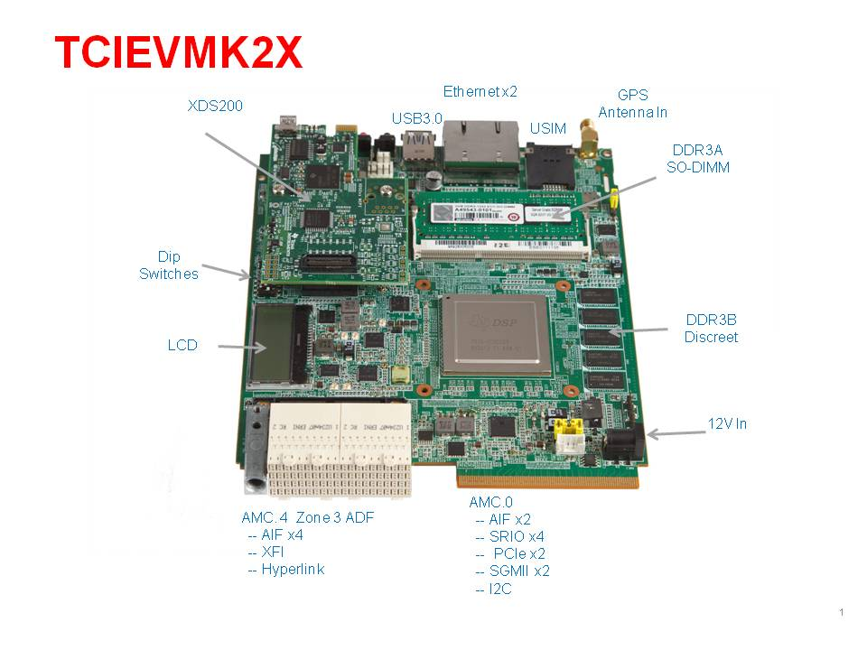
Texas Instruments' eight-core DSP+ four ARM core SoC (66AK2H12)
1024/2048 Mbytes of DDR3-1600 Memory on board
2048 Mbytes of DDR3-1333 ECC SO-DIMM
512 Mbytes of NAND Flash
16MB SPI NOR FLASH
Four Gigabit Ethernet ports supporting 10/100/1000 Mbps data-rate – two on AMC connector and two RJ-45 connector
170 pin B+ style AMC Interface containing SRIO, PCIe, Gigabit Ethernet, AIF2 and TDM
TWO 160 pin ZD+ style uRTM Interface containing HyperLink, AIF2 ,XGMII (not supported all EVMs)
128K-byte I2C EEPROM for booting
4 User LEDs, 1 Banks of DIP Switches and 3 Software-controlled LEDs
Two RS232 Serial interface on 4-Pin header or UART over mini-USB connector

Slide 12
Agenda
HPC Introduction
Keystone Architecture
  66AK2H12 and EVM
Multicore Software Development Kit
Programming Models
  A brief history of expression APIs/languages
  Keystone II Examples
Executive Summary
  Open MPI, OpenMP, OpenMP Accelerator and OpenCL, Libraries
Getting Started Guide/Next steps

Slide 13
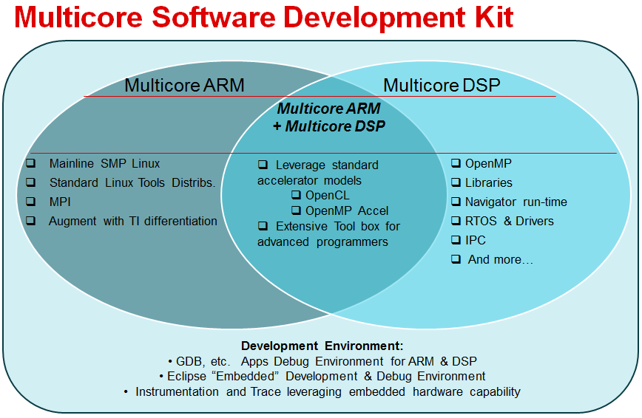
Multicore Software Development Kit

Slide 14
Multicore Software Development Kit
The Multicore Software Development Kit (MCSDK) provides foundational software for TI KeyStone II platforms, by encapsulating a collection of software elements and tools for both the A15 and the DSP.
MCSDK-HPC (High Performance Computing), built as an add-on on top of the foundational MCSDK, provides HPC specific software modules and algorithm libraries along with several out of box sample applications. SDKs together provides complete development environment [A15 + DSP] to offload HPC applications to TI C66x multi-core DSPs.
Key components provided by MCSDK-HPC
Category | Details
OpenCL | OpenCL (Open Computing Language) is a multi-vendor open standard for general-purpose parallel programming of heterogeneous systems that include CPUs, DSPs and other processors. OpenCL is used to dispatch tasks from A15 to DSP cores
Open MP on DSP | OpenMP is the de facto industry standard for shared memory parallel programming. Use OpenMP to achieve parallelism across DSP cores.
OpenMPI | Run on A15 cluster and use OpenMPI to allow multiple K2H nodes to communicate and collaborate.

Slide 15
Multicore Software Development Kit
Task distribution to different compute nodes
Communication between compute nodes
High throughput I/O for data exchange
Data share and movement
Compute resource management
Data Synchronization
Task distribution for multi-core processors
Parallelism program on multi-core processors
OpenMPI
OpenCL
OpenMP

Slide 16
Multicore Software Development Kit
HPC
Application
A15 SMP Linux
A15 SMP Linux
Ethernet
MPI
Hyperlink
MPI
OpenCL
IPC
SRIO
IPC
OpenCL
IPC
IPC
Shared memory/Navigator
K2H
K2H
Shared memory/Navigator
Kernel
Kernel
Kernel
Kernel
Kernel
Kernel
C66x subsystem
C66x subsystem
OpenMP
OpenMP
Run-time
Run-time
Node 0
Node 1

Slide 17


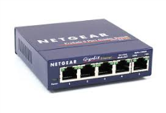

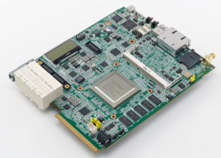
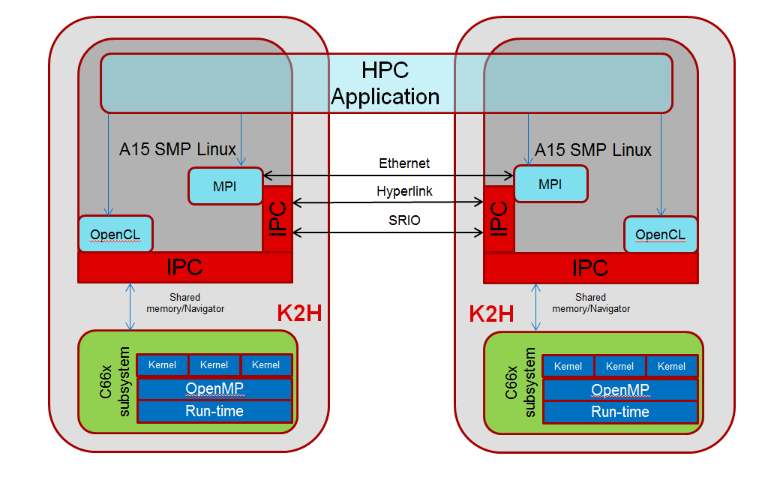
Multicore Software Development Kit (MCSDK) for High Performance Computing (HPC) Applications
Multinode FFT using OpenMPI, OpenCL and OpenMP using TCIC6636K2H Platform
Overview:
Multicore Software Development Kit for High Performance Computing (MCSDK-HPC) Applications provides the foundational software blocks and run-time environment for customers to jump start developing HPC applications on TI’s Keystone-2 SOCs.
Multiple Out of Box demos are provided to demonstrate the unified run-time with OpenMPI, OpenCL, OpenMP, and use it with DSP optimized algorithms such as FFTLib, BLAS.
Demo Setup
SSH terminal to EVMs
NFS
Demo1: Multinode computation for large-size (64K) FFTs
OpenMPI: Between SOC Nodes. I/O files are on NFS and shared
OpenCL: For A15 → C66x. A15 in each node reads 64K chunks from the shared input file and dispatches to C66x (as if there is 1 accelerator). All 8 cores are working on the same FFT. Results are written to output file on NFS
OpenMP: Between 8 C66x cores, to parallelize FFT execution
TCIC6636K2H EVM
TCIC6636K2H EVM
Application Partitioning + Software Architecture
Demo2: Multinode computation for small-size (512) FFTs
OpenMPI: Between SOC Nodes. I/O files are on NFS and shared
OpenCL: For A15→C66x. A15 in each node reads 64K chunks from the shared input file and dispatches to C66x (as if there are 8 accelerators). Each core works on a different FFT. OpenCL takes into account for out of order execution between cores. Results are written to output file on NFS.
OpenMP: Not used

Slide 18
Agenda
HPC Introduction
Keystone Architecture
  66AK2H12 and EVM
Multicore Software Development Kit
Programming Models
  A brief history of expression APIs/languages
  Keystone II Examples
Executive Summary
  Open MPI, OpenMP, OpenMP Accelerator and OpenCL, Libraries
Getting Started Guide/Next steps

Slide 19
Programming Models
(brief history of expression APIs/languages)
MPI Communication APIs
Node 0
Node 1
Node N

Slide 20
Programming Models
(brief history of expression APIs/languages)
MPI Communication APIs
OpenMP Threads
OpenMP Threads
OpenMP Threads
CPU
CPU
CPU
CPU
CPU
CPU
CPU
CPU
CPU
CPU
CPU
CPU
Node 0
Node 1
Node N

Slide 21
Programming Models
(brief history of expression APIs/languages)
MPI Communication APIs
OpenMP Threads
OpenMP Threads
OpenMP Threads
CPU
CPU
CPU
CPU
CPU
CPU
CPU
CPU
CPU
CPU
CPU
CPU
CUDA/OpenCL
CUDA/OpenCL
CUDA/OpenCL
GPU
GPU
GPU
Node 0
Node 1
Node N

Slide 22
Programming Model
On KeyStone II, Example 1
MPI Communication APIs
OpenMP Threads
OpenMP Threads
OpenMP Threads
CPU
CPU
CPU
CPU
CPU
CPU
CPU
CPU
CPU
CPU
CPU
CPU
OpenCL
OpenCL
OpenCL
DSP
DSP
DSP
Node 0
Node 1
Node N

Slide 23
Programming Model
On KeyStone II, Example 2
MPI Communication APIs
CPU
CPU
CPU
CPU
CPU
CPU
CPU
CPU
CPU
CPU
CPU
CPU
OpenCL
OpenCL
OpenCL
Node 0
Node 1
Node N

Slide 24
Programming Model
On KeyStone II, Example 3
MPI Communication APIs
CPU
CPU
CPU
CPU
CPU
CPU
CPU
CPU
CPU
CPU
CPU
CPU
OpenCL
OpenCL
OpenCL
OpenMP
OpenMP
OpenMP
Node 0
Node 1
Node N

Slide 25
Programming Model
On KeyStone II, Example 4
MPI Communication APIs
OpenMP Accel
OpenMP Accel
OpenMP Accel
CPU
CPU
CPU
CPU
CPU
CPU
CPU
CPU
CPU
CPU
CPU
CPU
Node 0
Node 1
Node N

Slide 26
Parallel Programming Recap
Acronym | Details
OpenMPI | Open Source High Performance Computing, Message Passing Interface (http://www.open-mpi.org/)
OpenCL | OpenCL (Open Computing Language) is a multi-vendor open standard for general-purpose parallel programming of heterogeneous systems that include CPUs, DSPs and other processors. OpenCL is used to dispatch tasks from A15 to DSP cores (https://www.khronos.org/opencl/)
OpenMP | OpenMP is the de facto industry standard for shared memory parallel programming. (http://openmp.org/)
OpenMP Accelerator | Subset of OpenMP 4.0 specification that enables execution on heterogeneous devices

Slide 27
Agenda
HPC Introduction
Keystone Architecture
  66AK2H12 and EVM
Multicore Software Development Kit
Programming Models
  A brief history of expression APIs/languages
  Keystone II Examples
Executive Summary
  Open MPI, OpenMP, OpenMP Accelerator and OpenCL, Libraries
Getting Started Guide/Next steps

Slide 28
Executive Summary - OpenMPI
OpenMPI is an open source, high-performance implementation of MPI (Message Passing Interface) which is a standardized API used for parallel and/or distributed computing.
MPI program allows concurrent operation of multiple instances of identical program on all nodes within "MPI Communication World".
Instances of same program can communicate with each other using Message Passing Interface APIs.
Launching and initial interfacing (e.g. exchange of TCP ports) of all instances is handled by ORTED (OpenMPI specific) process started typically using "SSH".
Properly configured "SSH" is necessary (TCP/IP connectivity is needed independent of other available transport interfaces).
MPI Application developer views cluster as set of abstract nodes with distributed memory

Slide 29
Executive Summary - OpenMP
API for specifying shared-memory parallelism in C, C++, and Fortran
Consists of compiler directives, library routines, and environment variables
  Easy & incremental migration for existing code bases
  De facto industry standard for shared memory parallel programming
Portable across shared-memory architectures
Evolving to support heterogeneous architectures, tasking dependencies etc.
Notes:
29

Slide 30
Executive Summary – OpenMP Acc Model
Pragma based model to dispatch computation from host to accelerator
(K2H ARMs to DSPs)
float a[1024];
float b[1024];
float c[1024];
int size;
void vadd_openmp(float *a, float *b, float *c, int size)
{
#pragma omp target map(to:a[0:size],b[0:size],size) map(from: c[0:size])
{
int i;
#pragma omp parallel for
for (i = 0; i < size; i++)
c[i] = a[i] + b[i];
}
}
Variables a, b, c and size initially reside in host memory
On encountering a target construct:
  Space is allocated in device memory for variables a[0:size], b[0:size], c[0:size] and size
  Any variables annotated ‘to’ are copied from host memory to device memory
  The target region is executed on the device
  Any variables annotated ‘from’ are copied from device memory to host memory

Slide 31
Executive Summary – OpenCL
OpenCL is a framework for expressing programs where parallel computation is dispatched to any attached heterogeneous devices.
OpenCL is open, standard and royalty-free.
OpenCL consists of two relatively easy to learn components:
  An API for the host program to create and submit kernels for execution
    A host based generic header and a vendor supplied library file
  A cross-platform language for expressing kernels
    Based on C99 C with a some additions, some restrictions and built-in functions
OpenCL promotes portability of applications from device to device and across generations of a single device roadmap, by
  Abstracting the job dispatch mechanism, and
  Using a more descriptive rather than prescriptive data parallel kernel + enqueue mechanism.

Slide 32
OpenCL Example Code
OpenCL Host Code
Context context (CL_DEVICE_TYPE_ACCELERATOR);
vector<Device>devices = context.getInfo<CL_CONTEXT_DEVICES>();
Program program(context, devices, source);
Program.build(devices);
Buffer buf (context, CL_MEM_READ_WRITE, sizeof(input));
Kernel kernel (program, "mpy2");
kernel.setArg(0, buf);
CommandQueue Q (context, devices[0]);
Q.enqueueWriteBuffer (buf, CL_TRUE, 0, sizeof(input), input);
Q.enqueueNDRangeKernel(kernel, NDRange(globSz), NDRange(wgSz));
Q.enqueueReadBuffer (buf, CL_TRUE, 0, sizeof(input), input);
OpenCL Kernel
Kernel void mpy2(global int *p)
{
int i = get_global_id(0);
p[i] *= 2;
}
The host code is using the optional OpenCL C++ bindings
  It creates a buffer and a kernel, sets the arguments, writes the buffer, invokes the kernel and reads the buffer.
The DSP code is purely algorithmic
  No dealing with DMA’s, cache flushing, communication protocols, etc.

Slide 33
Executive Summary – Libraries
Library | Details
FFTLIB | API similar to FFTW, includes FFT plan and FFT execute
BLAS | Basic Linear Algebra Subprograms
Libflame | High performance dense linear algebra library
DSPLIB | Includes C-callable, general-purpose signal-processing routines that are typically used in computationally intensive real-time applications
IMGLIB | Optimized image/video processing function library for C programmers
MATHLIB | Optimized floating-point math function library for C programmers using TI floating point devices

Slide 34
Agenda
HPC Introduction
Keystone Architecture
  66AK2H12 and EVM
Multicore Software Development Kit
Programming Models
  A brief history of expression APIs/languages
  Keystone II Examples
Executive Summary
  Open MPI, OpenMP, OpenMP Accelerator and OpenCL, Libraries
Getting Started Guide/Next steps

Slide 35
Getting Started Guide/Next steps
Bookmarks | URL
Download | http://software-dl.ti.com/sdoemb/sdoemb_public_sw/mcsdk_hpc/latest/index_FDS.html
Getting Started Guide | http://processors.wiki.ti.com/index.php/MCSDK_HPC_3.x_Getting_Started_Guide
OpenMPI | http://processors.wiki.ti.com/index.php/MCSDK_HPC_3.x_OpenMPI
OpenMP | http://processors.wiki.ti.com/index.php/MCSDK_HPC_3.x_OpenMP
OpenCL | http://processors.wiki.ti.com/index.php/MCSDK_HPC_3.x_OpenCL
Support | http://e2e.ti.com/support/applications/high-performance-computing/f/952.aspx

Slide 36
Back up

Slide 37
TI KeyStone MCSDK
ARM DSP
Demo Applications
Optimized
Algorithm Libraries
Protocols Stack
User Space
Codecs
IMGLIB
Debug and Instrumentation
Transport Lib
IPC
TCP/IP
NDK
MathLIB
DSPLIB
SYS/BIOS RTOS
OpenCL
OpenMP
OpenEM
SW Framework
Multicore Runtime
Kernel Space
IPC
Debug and Instrumentation
OpenMP
OpenEM
Linux OS
Scheduler
Power Management
Network Protocols
Low Level Drivers
Platform SW
NAND File System
MMU
Network File System
Navigator
EDMA
Platform Library
Device Drivers
HyperLink
Power
Management
Transport Lib
NAND/
NOR
HyperLink
GbE
PCIe
Power on Self Test
SRIO
GbE
PCIe
Boot Utility
SRIO
UART
SPI
I2C
Chip Support Library
KeyStone SoC Platform
TeraNet
ARM CorePacs
AccelerationPacs, L1,2,3,4
Memory
Ethernet Switch
IO
DSP CorePacs
Multicore Navigator

